Slide 1
Can you hear us ?
Listening and Learning
from engagement with parents and carers
Helen Dunn
Independent Social Worker

Slide 2
Independent Review of Children`s Social Care
Professor Ray Jones , Marie Roulston , Professor Pat Dolan , Judge Patricia Smyth
In February 2022 the Department of Health announced that an Independent Review of Children’s Social Care in Northern Ireland would be undertaken, led by Professor Ray Jones
Children in Northern Ireland (CiNI) was commissioned to support the review by ensuring its work would be informed by the views and experiences of parents and carers of children, who have received services.
Participants were provided with the opportunity to contribute their opinions and ideas to the work of the review.
Face to face meetings with Prof. Jones
Attendance at workshops
178 parents and carers – 16 groups and 1-1 conversation
VOYPIC - Experts by Experience Reference Group

Slide 3
The Consultation Groups
Parents of children with disabilities
Prisoners families
Women impacted by domestic abuse
Newcomer families
Adoptive parents
Parents with young children
Mothers whose children are in the care of the state
Parents currently engaged with Social Services

Slide 4
Key themes
Lack of support and services
Relationships and power
Workforce issues
Staff training
Structural issues
Voluntary and community sector contributions
Co-production
Parents and carers want to contribute

Slide 5
Challenges
Lack of support and services
Rural areas
Newcomer families
Access to family support outside SureStart areas
Disability Support
Long waiting lists
Mental health services

Slide 6
Challenges
Workforce issues
“my kids have had 10 different social workers – the children build up a bond and then they disappear , and they get a new social worker and they get re-traumatised by having to re-tell the abuse” (Women`s Aid)
“having a different person for contact was really challenging – our daughter was reaching a stage where she recognised people as familiar or unfamiliar and our anxiety levels increased through having to leave her with a different person each time”
(Home for Good)

Slide 7
Challenges
Lack of experience
“I feel newly qualified social workers want to make a difference and are actually quite good at the job but it is so hard it sucks the life out of them. To the point where they become hardened and unapproachable” (Women`s Aid)
“we need an overhaul of the system- more social workers, manageable caseloads that’s not causing stress- the Trust is on its knees” (Together as One)
Training needed - in autism, addictions, domestic abuse, cultural awareness

Slide 8
Challenges
Structures
Post code lottery for children with a disability
5 Trusts ?
Mental health and addictions separate
Disjointed support
Too much bureaucracy
Transitions for disabled children
“everything is in silos – the Trust should work with education , the youth service , with the voluntary sector- with schools even , the buildings are there , the staff are potentially in schools…”
This Photo by Unknown Author is licensed under CC BY-NC-ND

Slide 9
What parents said worked for them
Practical support
“there should be funding for support workers to complement social workers – fill the gaps doing practical stuff” (NIACRO)
“the focus is too much on assessment , surveillance and monitoring – not enough on practical support” (Together as One)
“ when my house flooded it was Women`s Aid who brought the practical help , clearing the place out , buying furniture, cleaning up – I could not have done it on my own. “

Slide 10
What parents said worked for them
Early Help and Family Support
“there`s a lack of early intervention – which actually leads to mental health problems” (Autism NI)
“you have to have a breakdown before you get help – if social workers – if social workers don’t look after the parents there will be no one to look after the child” (Parent of a child with a disability)

Slide 11
What parents said worked for them
Positive Relationships
“there was one social worker who I felt really cared about me and I had a relationship with and I asked for her when my last child was being taken and I felt she was there for me” (Pause)
“ they hold your life in their hands”. (Pause – birth parents)
Advocacy
Parents and carers who availed of support from NIACRO and Women`s Aid stressed the importance of having someone to represent and speak up for them.
They could address the power imbalance - could challenge and be able to explain court and admin processes

Slide 12
What parents said worked for them
Peer support
“its so hard to quantify the feeling of safety , being heard , and being held – and being in a group of women who are in the same position- its so freeing, it brought me out the other side”
(ABC PIP)
“Everyone would benefit from meeting with other parents – we all have different stories but we get so much support from sharing with each other” (Together as One)

Slide 13
What parents said worked for them
Lets work together
“Services should be working in partnership with parents.”
“Some of the burden should be removed from social workers, for their protection, by developing peer support and buddy systems.”
“Even though services aren’t perfect, this parent’s forum is proof that change is possible, that people do want to do better – it gives me a sense of hope.”

Slide 14
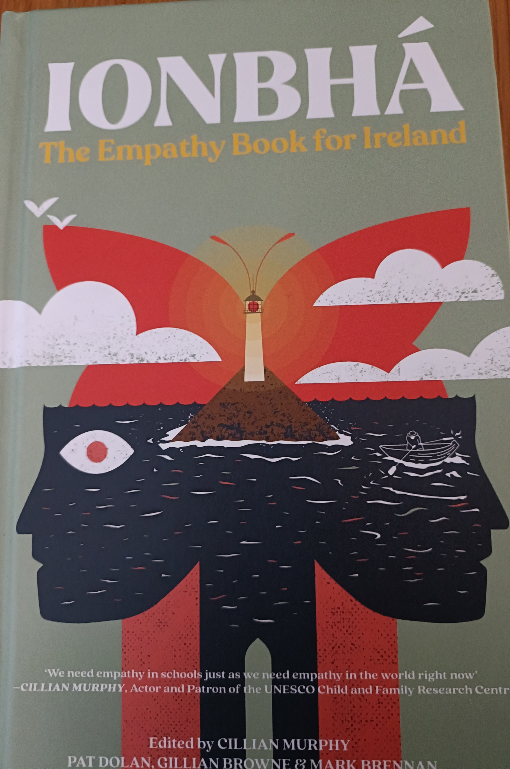
IONBHÁ The Empathy Book of Ireland ed. Cillian Murphy, Pat Dolan , Gillian Browne & Mark Brennan
“Today, compassion , empathy and kindness are at the core of our capacity to respond and recover from any current crisis and can be our anchor and inoculation as we face inevitable future challenges.”

